Slide 1
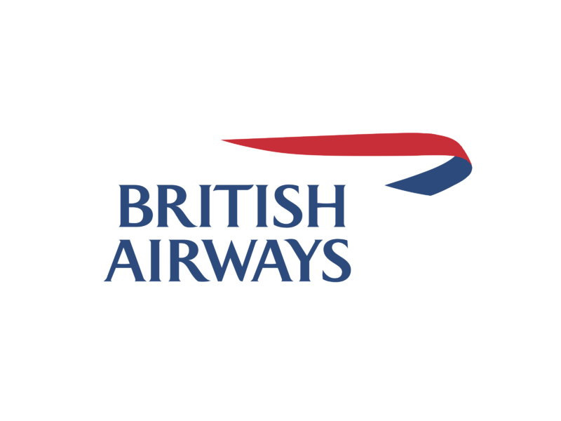

INDUSTRY PROJECT - FANTASTIC 4

Slide 2

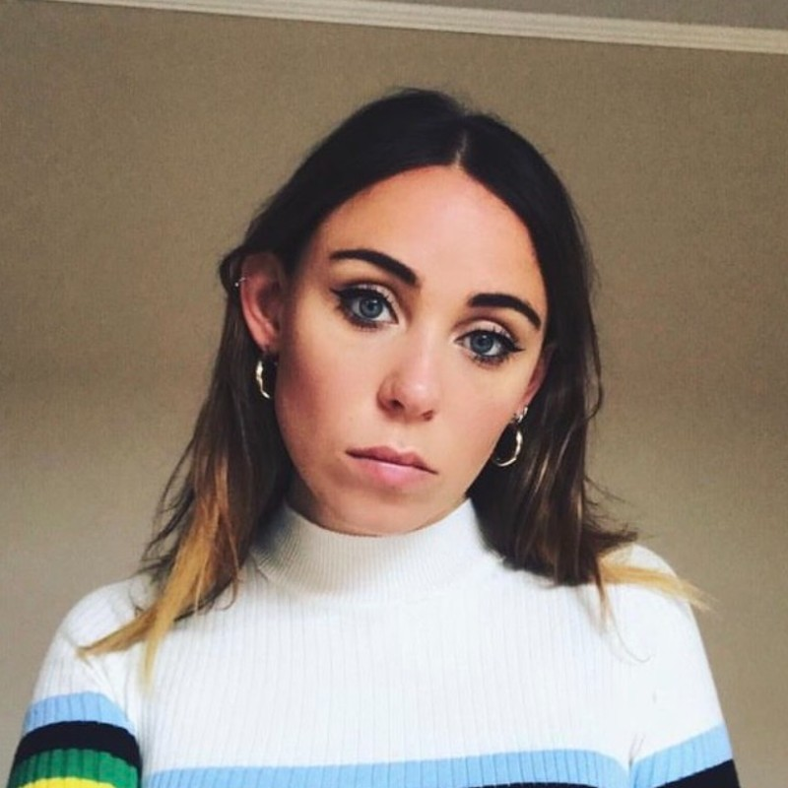
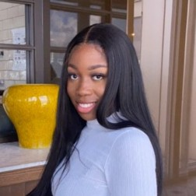
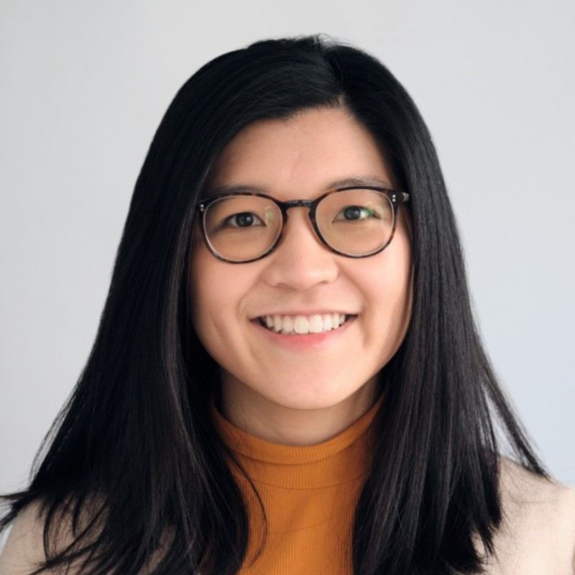
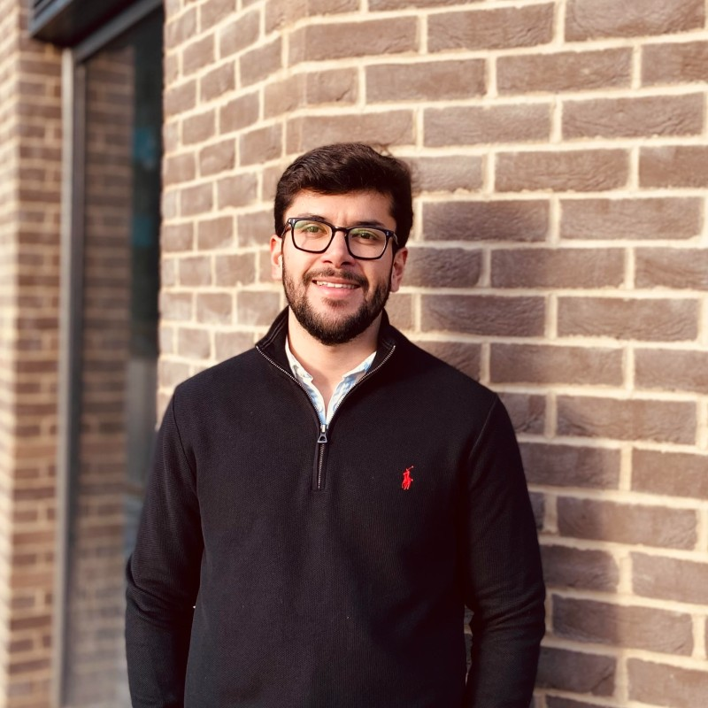


Team members
Data scientists
UX designers
Software engineers
Helen
Olabisi
Christie
Daniel
Jonny
Luis

Slide 3
Problem Statement:
How can we encourage younger leisure customers to buy seats in “Club World” cabin?

Slide 4
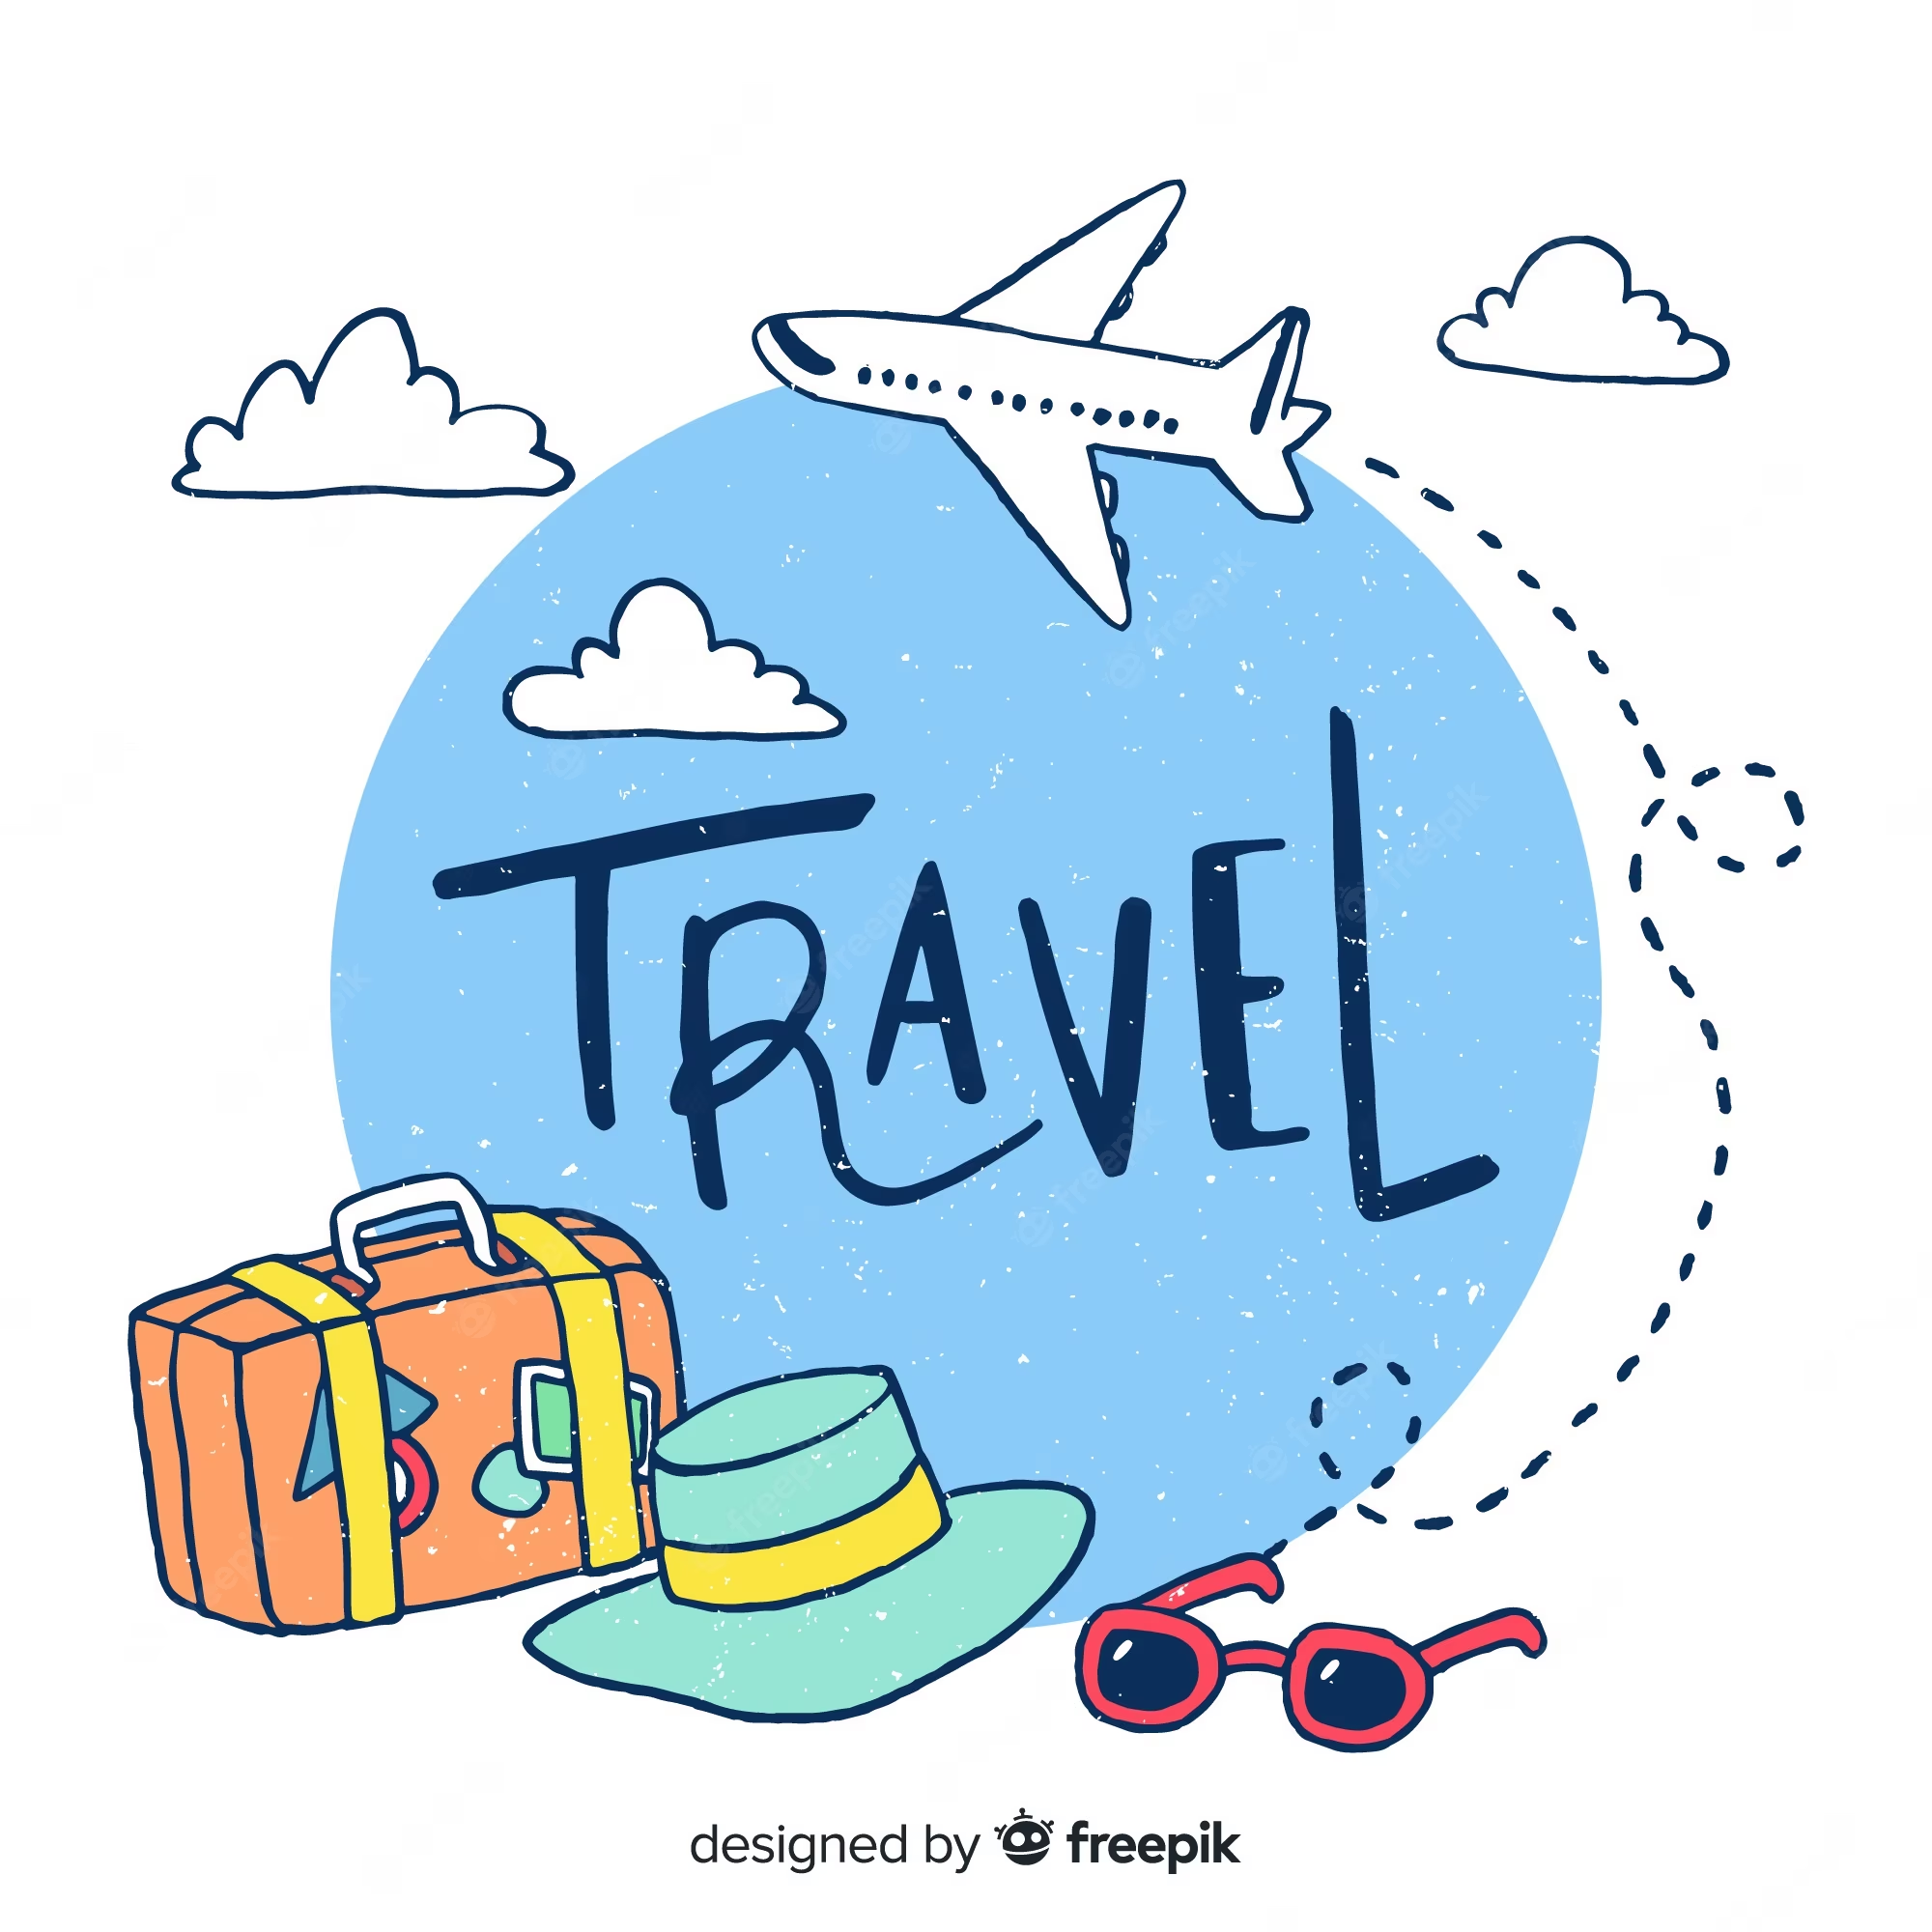
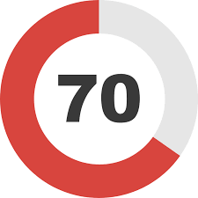
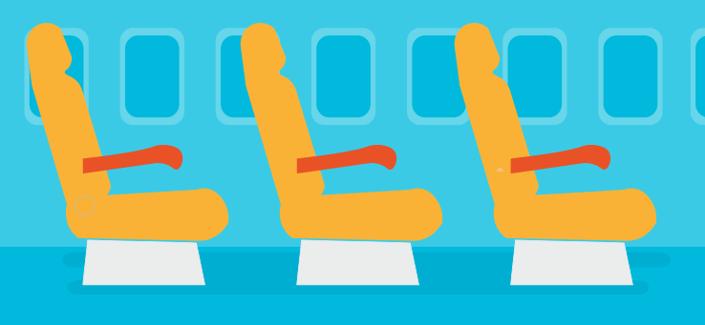
Insights
Gen Zs and Millennials are the highest spenders when they travel
Millennials are 60% more likely to purchase seats with extra legroom while flying.
70% Gen-Z belong to Premium Loyalty programmes
Notes:
68% of millennials and 66% of Gen Z prefer comfort over speed when choosing a mode of transportation
Millennials are 60% more Comfort over speed Millennials are 60% more likely to purchase seats with extra legroom while flying.
.

Slide 5
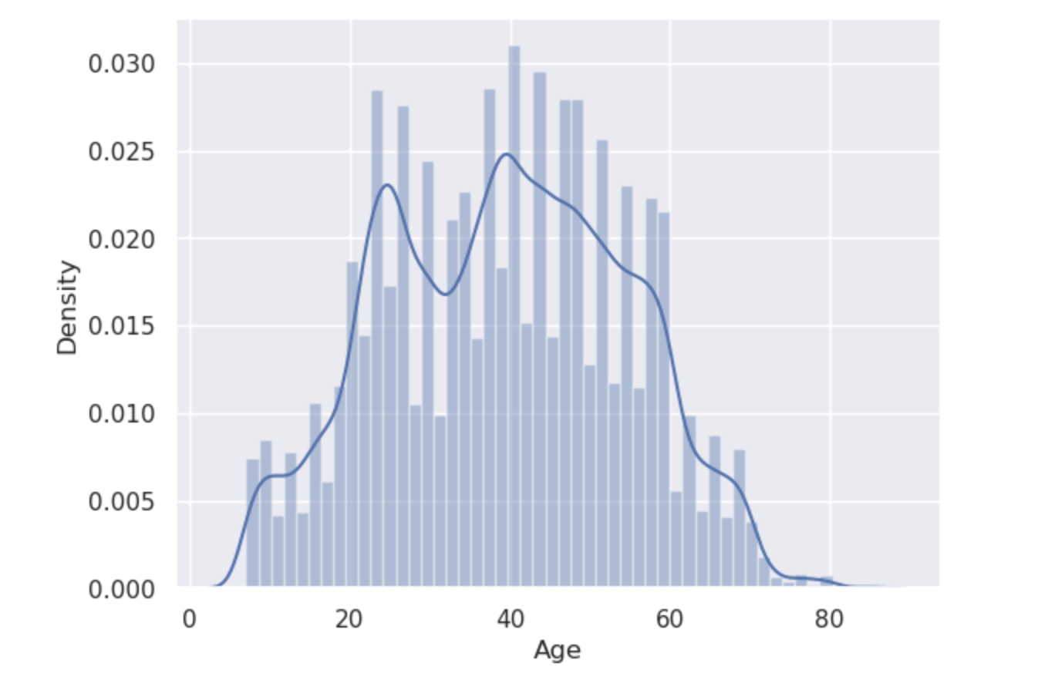
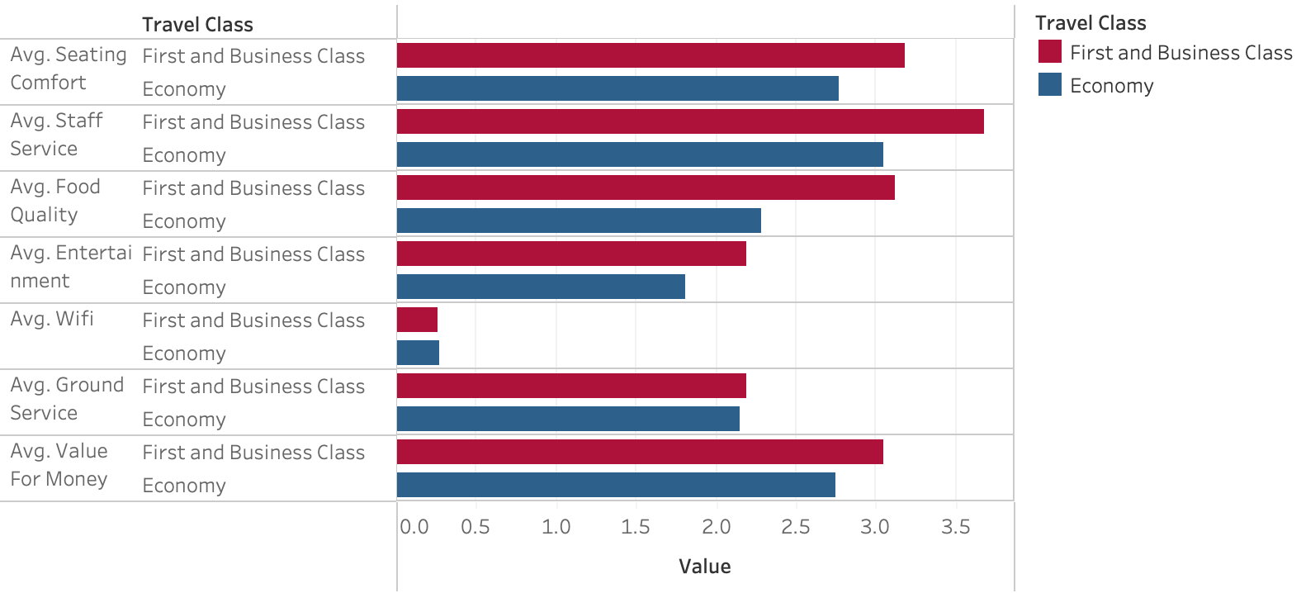
What did we find?
GEN Z BUY ALMOST AS MANY FLIGHTS AS OLDER GENERATION
FIRST CLASS IS BETTER VALUE FOR MONEY
1. US AIRLINES SENTIMENT, KAGGLE
2. BRITISH AIRWAYS REVIEWS, KAGGLE
Notes:
HIGHER AVERAGE RATINGS IN PREMIUM FOR:
STAFF SERVICE
COMFORT
VALUE FOR MONEY
FOOD
ENTERTAINMENT

Slide 6
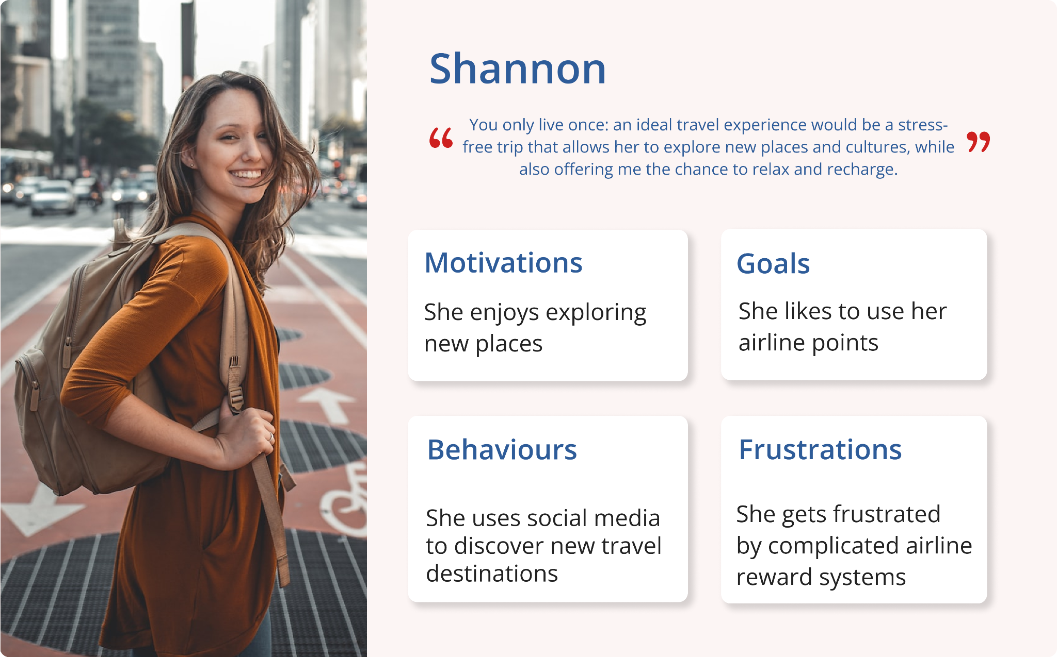
User persona

Slide 7
How might we
encourage other young leisure travellers like Shannon, an existing BA customer, to upgrade to a higher cabin.

Slide 8
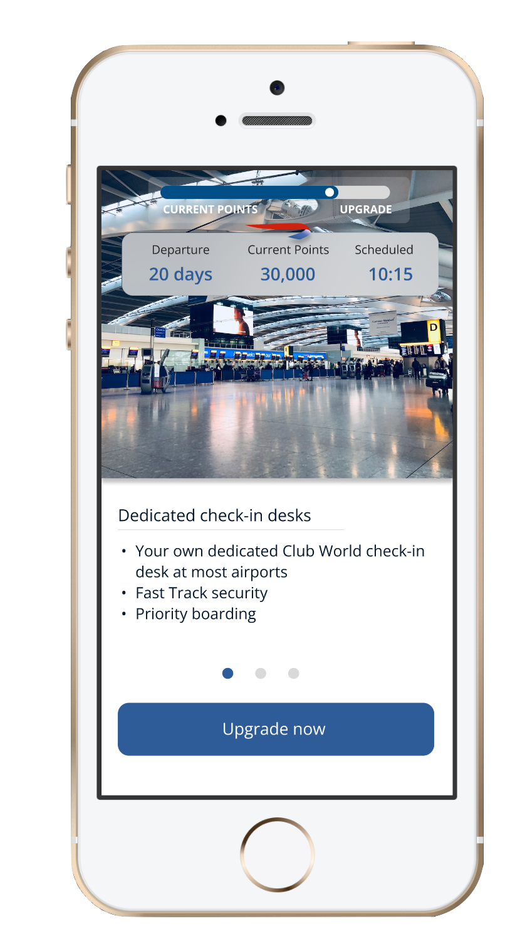
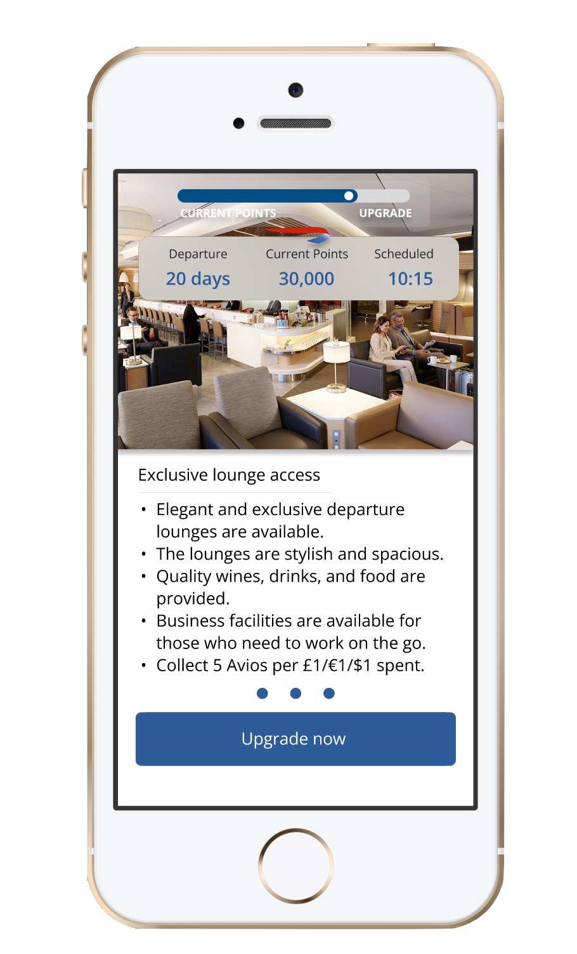
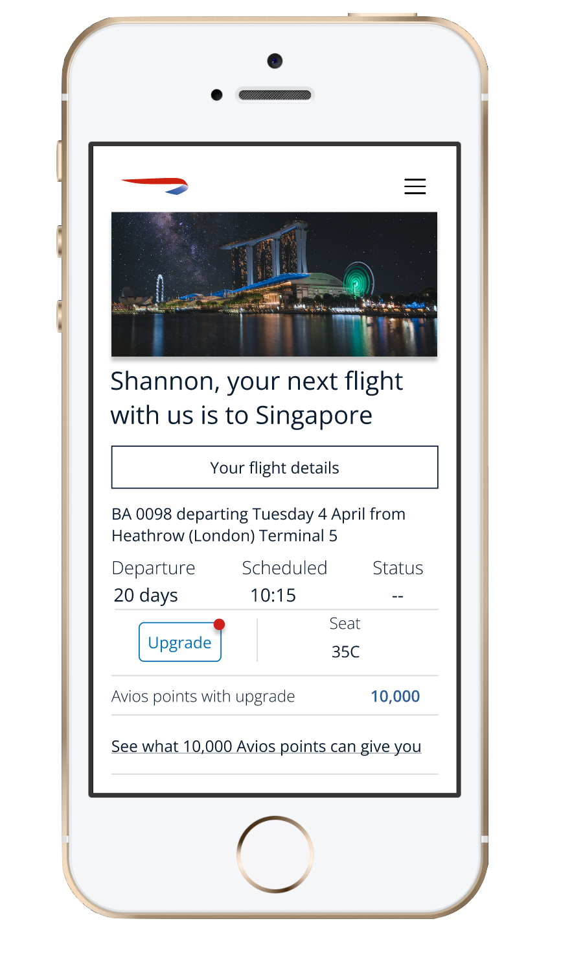
High-fidelity wireframes

Slide 9
Demo
Notes:
Tech stack used React, SASS

Slide 10
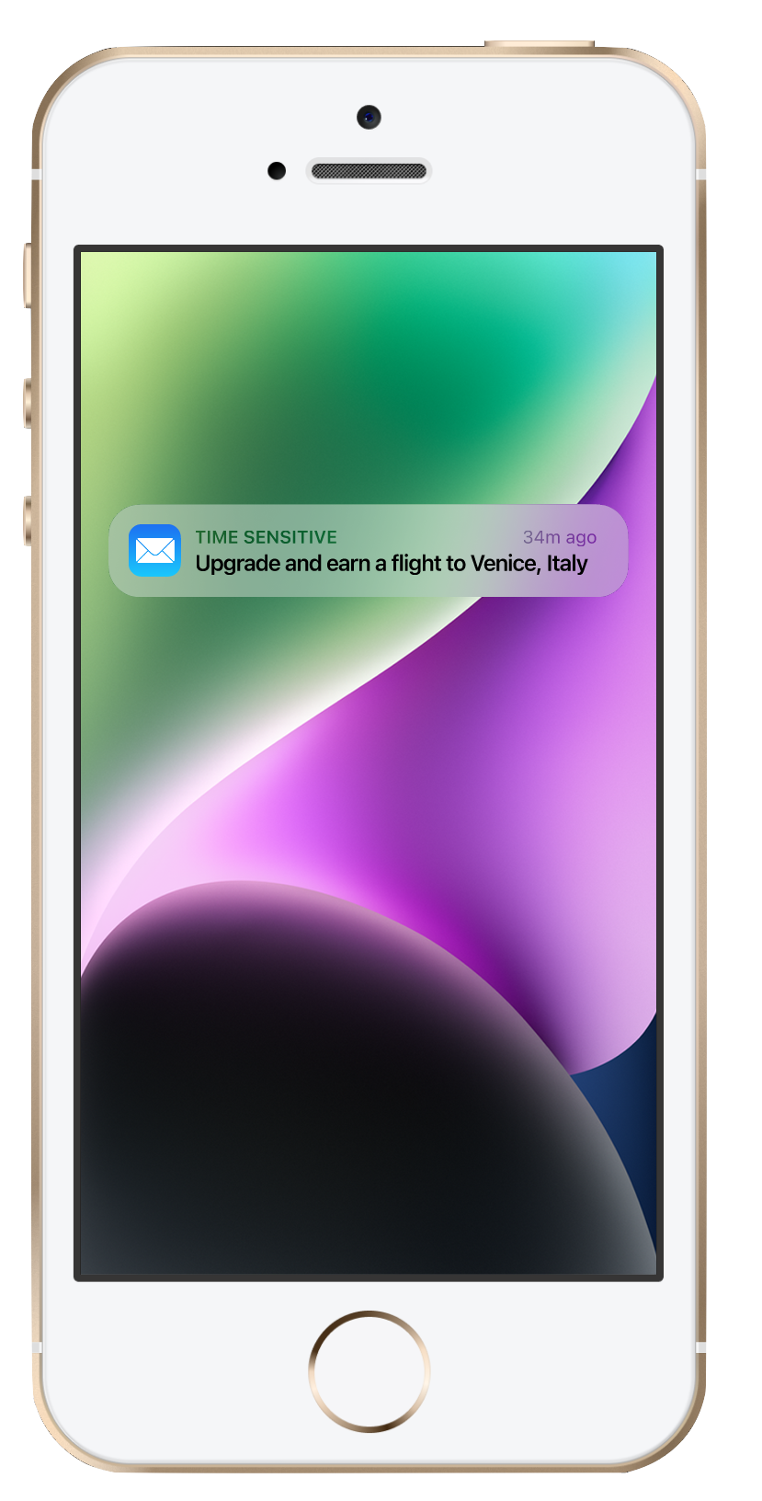
Notes:
Encourage customers with an upcoming flight to upgrade to a higher cabin.
Send push notifications to promote Avios rewards
Step-by-step guide of luxury travel experience

Slide 11
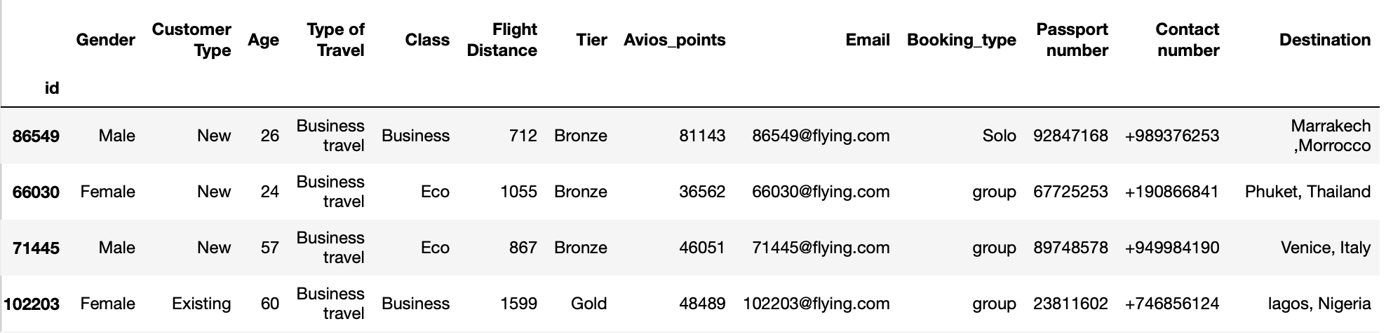
Implementing in industry
DATA WIREFRAME AND RECOMMENDATION SYSTEM
COLLECT DATA:
Customer demographic
Number of Avios points
Click rate
Conversion rate
RECOMMEND REWARDS BASED ON:
Previous Destinations
Popular Destinations by age group and trend
Popular Avios hotel partners

